Slide 1
Computational Quantum Mechanics
Prof. Gerson J. Ferreira
INFIS/UFU 2020/1
Eigenstates of 2D systems
https://gitlab.com/gersonjferreira/computational-quantum-mechanics

Slide 2
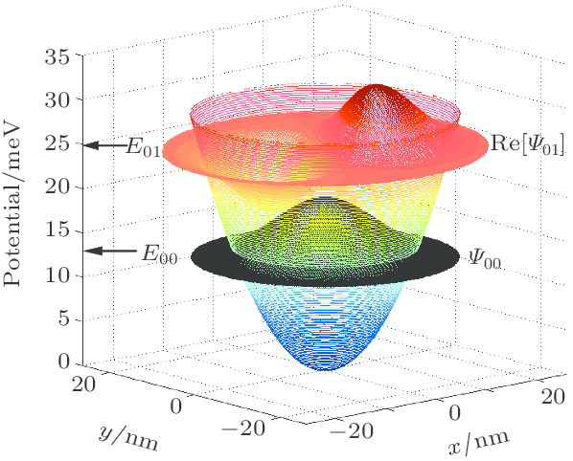
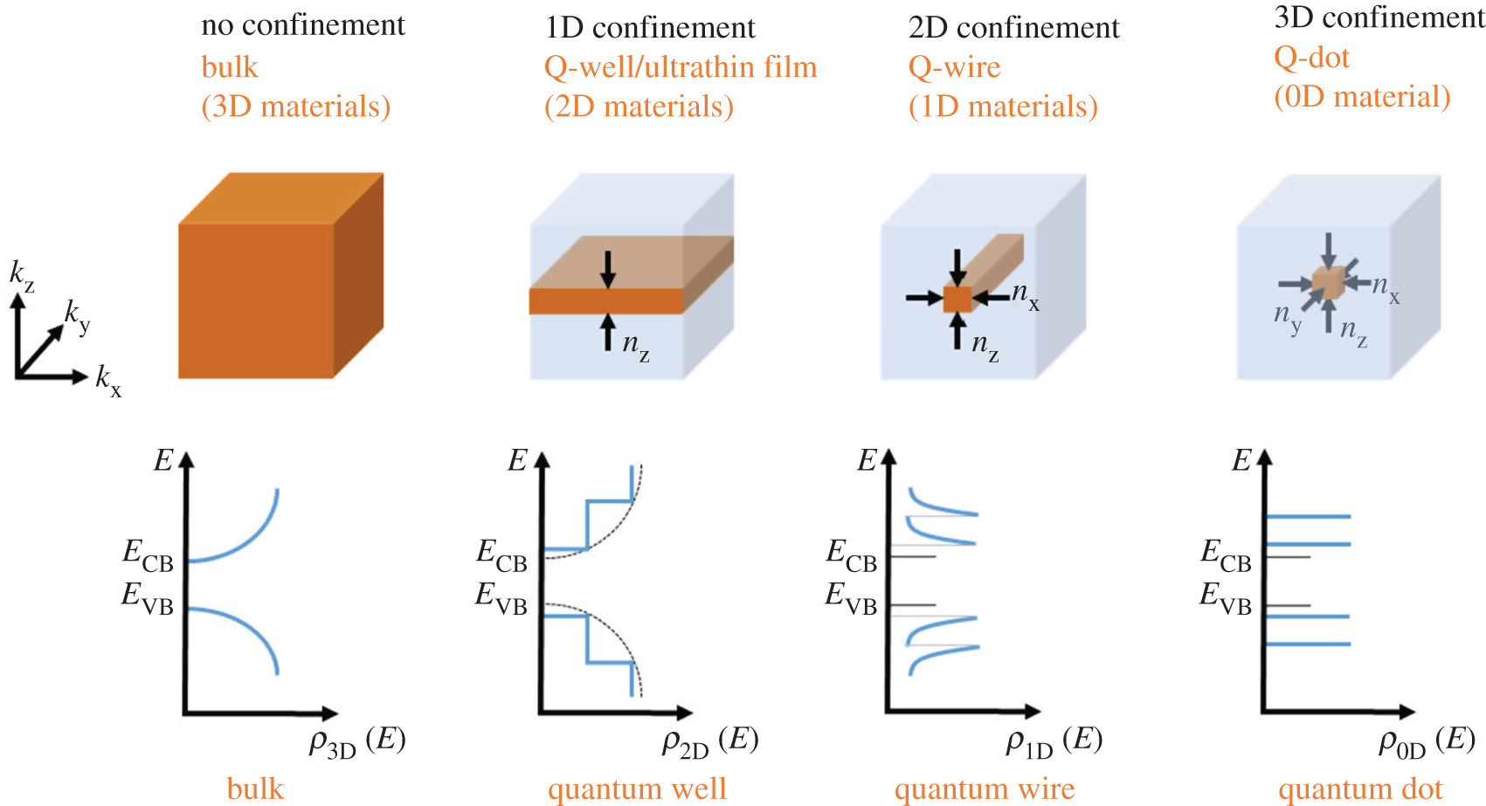
2D systems
Now we want to consider a 2D Hamiltonian and solve:
[Song et al. Chinese Phys. B 21, 057302 (2012)]
[Edvinsson, R. Soc. Open Sci. 5, 180387 (2018)]

Slide 3
Matrix representation for finite differences
Before, for 1D systems we had ψ(x)
it was natural to write ψ(x) as a vector on the discrete coordinates:
...
where

Slide 4
Matrix representation for finite differences
But now we have ψ(x, y): how do we organize it as a vector?
Label each point as
In Python… use:
np.meshgrid(...)
.flatten()
np.kron(...)
Sort as
To get →
p0 = (0, 0)
p1 = (1, 0)
p2 = (2, 0)
p3 = (0, 1)
p4 = (1, 1)
p5 = (2, 1)
p6 = (0, 2)
p7 = (1, 2)
p8 = (2, 2)
(0,2) (1,2) (2,2)
(0,1) (1,1) (2,1)
(0,0) (1,0) (2,0)
y
x

Slide 5



How these python commands work? meshgrid and flatten
meshgrid: convert vectors x, y into coordinate matrices
flatten: collapses the array into one dimension
You can also
use kron!
see next slides
vectors [0, 1, 2]
Matrix:
|0,0,0|
|1,1,1|
|2,2,2|
The matrix elements form the pairs pn = (xn, yn)
Matrix:
|0,1,2|
|0,1,2|
|0,1,2|
x→
To linearize into vectors, use .flatten()
pn = (xn, yn)
x→
y→
(0, 0)
(1, 0)
(2, 0)
(0, 1)
(1, 1)
(2, 1)
(0, 2)
(1, 2)
(2, 2)
y→
x→
y→
0
1
2
0
1
2
0
1
2
0
0
0
1
1
1
2
2
2
(0,2) (1,2) (2,2)
(0,1) (1,1) (2,1)
(0,0) (1,0) (2,0)
y
Now check this:
→ is this useful? ;-)
x

Slide 6


How these python commands work? kron
kron: is the Kronecker product, or the direct product → ⊗
pn = (xn, yn)
If A and B are matrices:
(0, 0)
(1, 0)
(2, 0)
(0, 1)
(1, 1)
(2, 1)
(0, 2)
(1, 2)
(2, 2)
Consider now the 1D matrix representations for these operators
(see previous classes)
The 2D version becomes:
So we get:

Slide 7
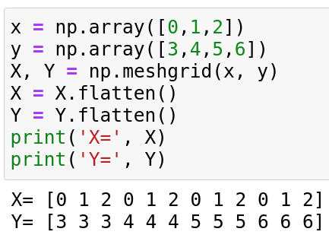
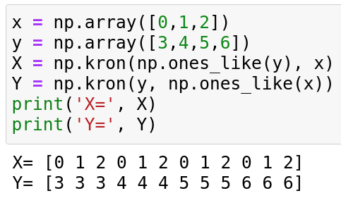
Using kron instead of meshgrid and flatten
Check that these codes return the same vectors:
Using meshgrid/flatten
Using kron

Slide 8
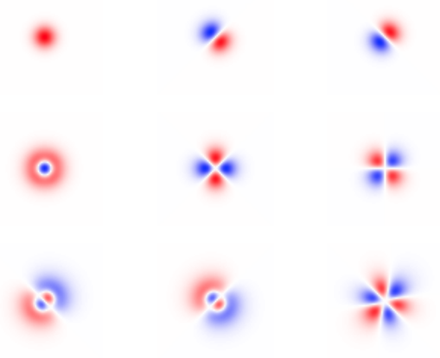
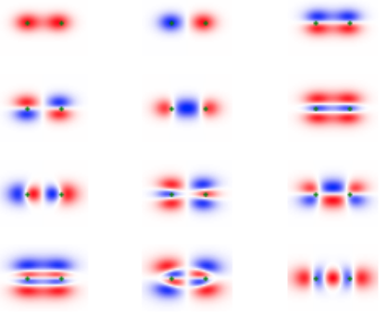
Results for 2D atoms or molecules
Atomic potential = inverse Gaussian
1 atom
2 atoms

Slide 9
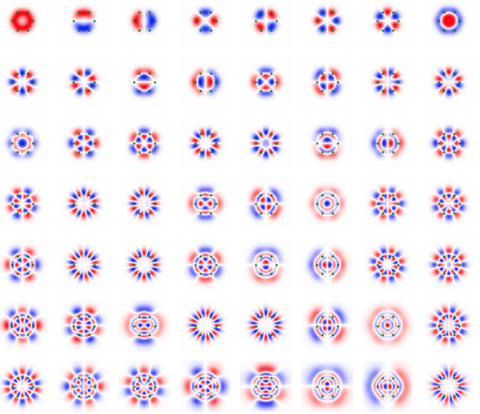
Results for 2D atoms or molecules
6 atoms
hexagon

Slide 10
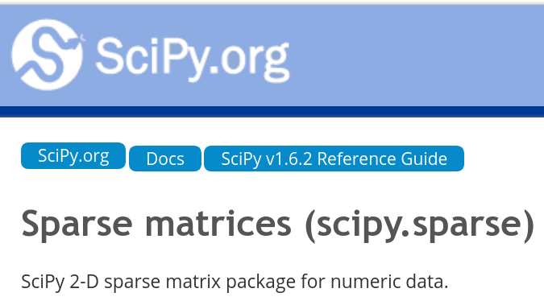
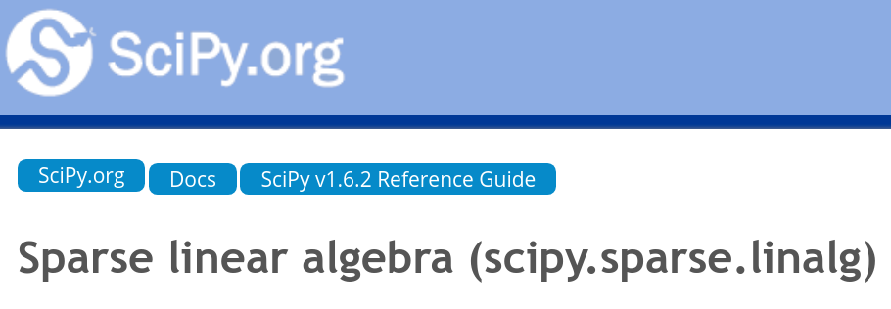
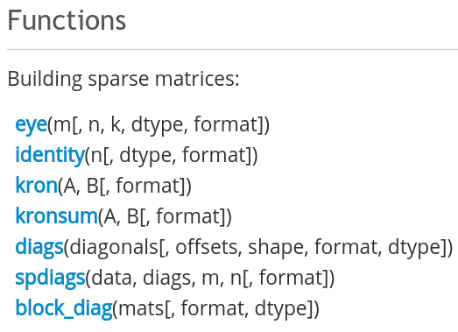
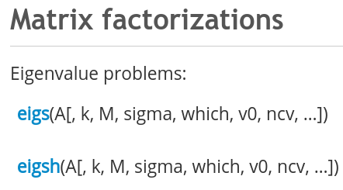
How to improve? For large matrices: use scipy sparse matrices

